Slide 1
TOWN OF HARDWICK ESSENTIAL SERVICES
Community Outreach
Town of Hardwick – Essential Services
Hardwick, Vermont
January 21, 2026

Slide 2
AGENDA
1. Welcome & Opening Remarks — Town Manager (Partner Introductions) |  |  | 5 minutes
2. Project Background — How We Got Here |  |  | 10 minutes
3. Project Overview & Proposed Development |  |  | 15 mins.
4. Project Costs & Funding Opportunities |  |  | 15 mins.
5. Community Discussion & Questions |  |  | 30 minutes
6. Next Steps |  |  | 5 mins.
7. Closing Remarks Total Time : 1 hr 20 mins +/- |  |  | 2-3 minutes
Town of Hardwick – Essential Services
Hardwick, Vermont
January 21, 2026

Slide 3
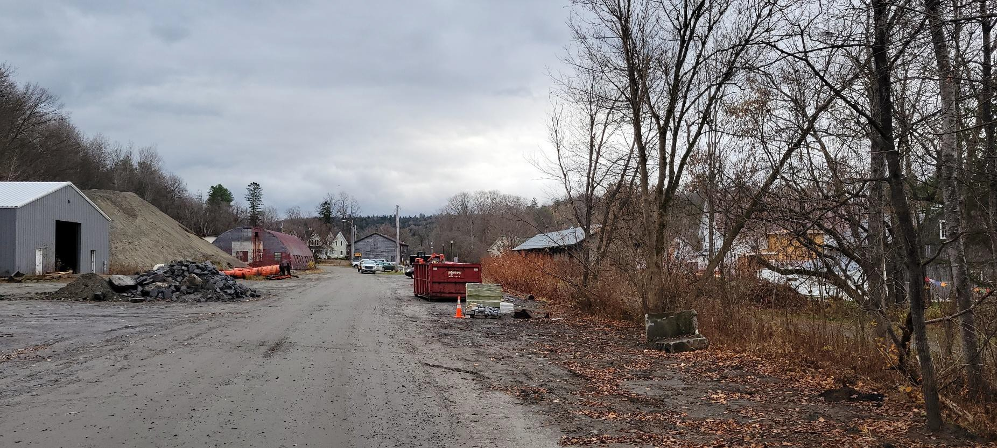
HARDWICK ESSENTIAL SERVICES
Town of Hardwick – Essential Services
Hardwick, Vermont
January 21, 2026

Slide 4
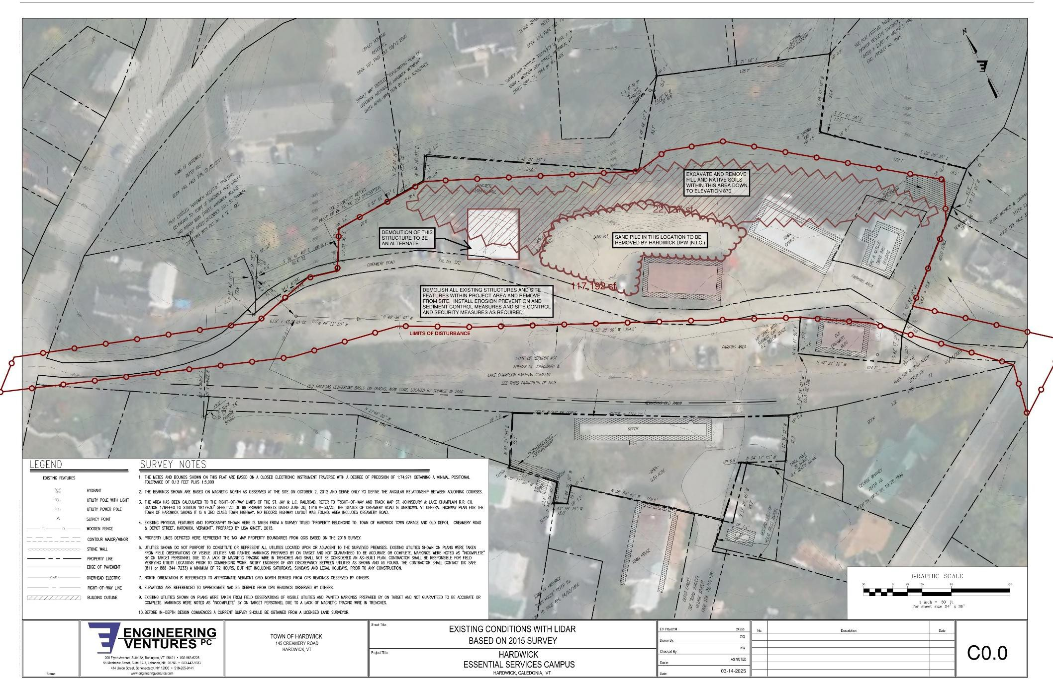
EV EXISTING CIVIL
Town of Hardwick – Essential Services
Hardwick, Vermont
January 21, 2026

Slide 5
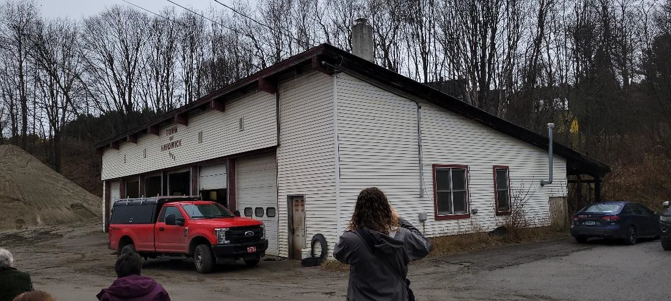
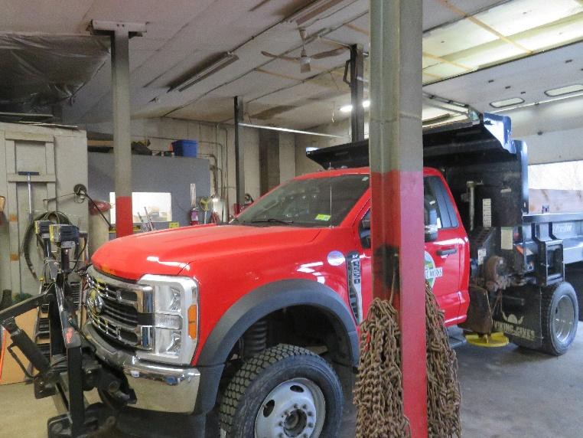
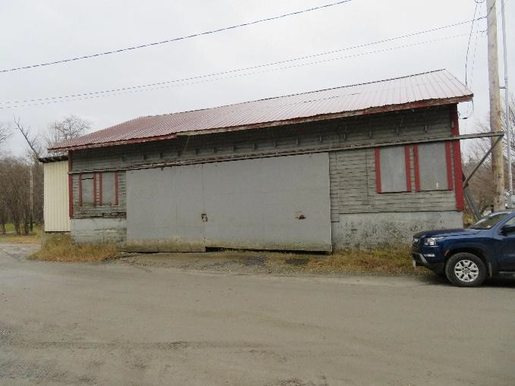
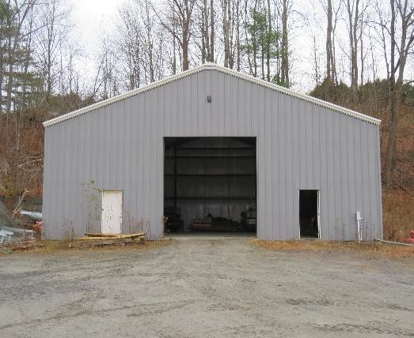
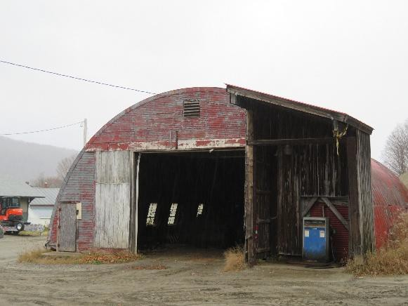
HARDWICK D.P.W.
Town of Hardwick – Essential Services
Hardwick, Vermont
January 21, 2026

Slide 6
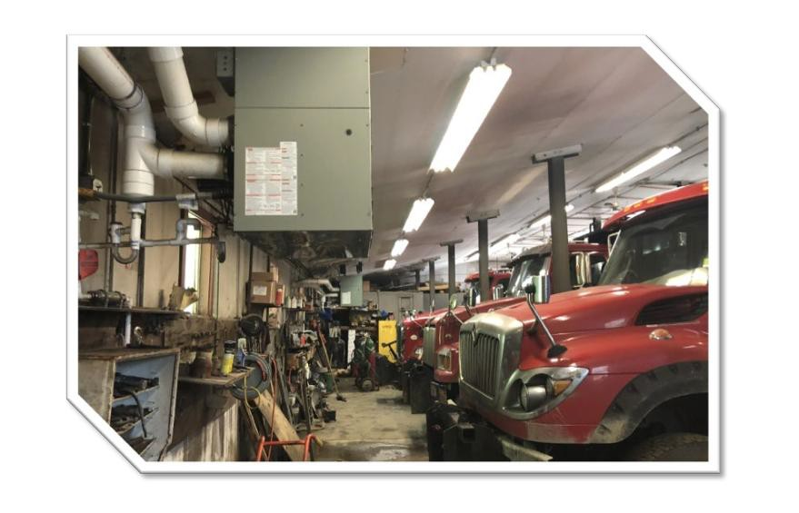
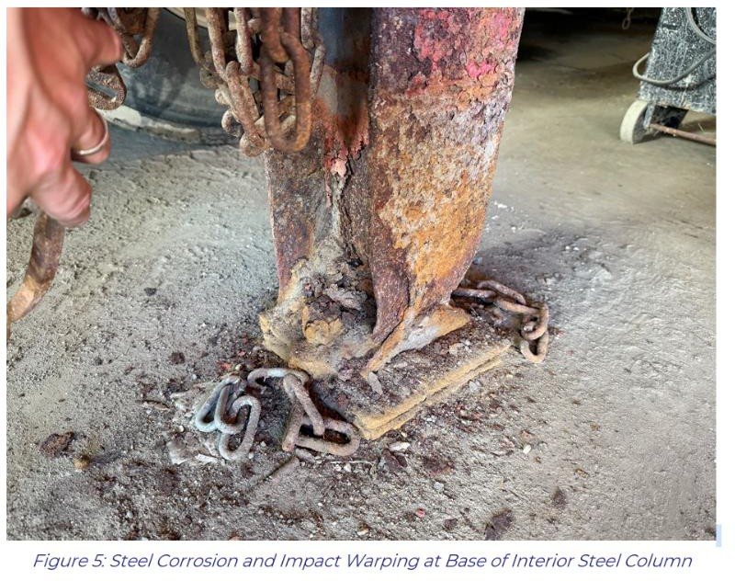
HARDWICK D.P.W.
Town of Hardwick – Essential Services
Hardwick, Vermont
January 21, 2026

Slide 7
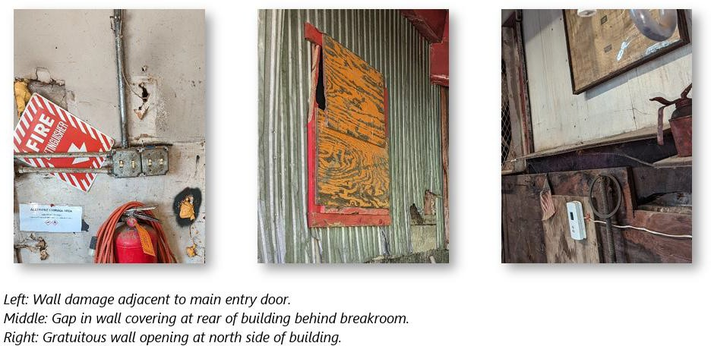
HARDWICK D.P.W.
Town of Hardwick – Essential Services
Hardwick, Vermont
January 21, 2026

Slide 8
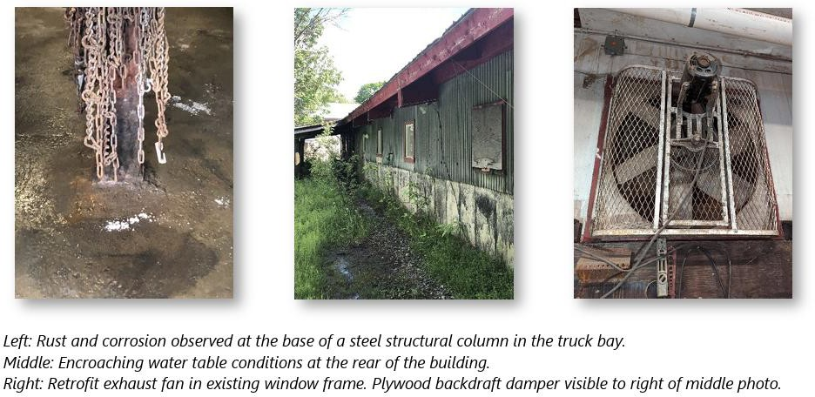
HARDWICK D.P.W.
Town of Hardwick – Essential Services
Hardwick, Vermont
January 21, 2026

Slide 9
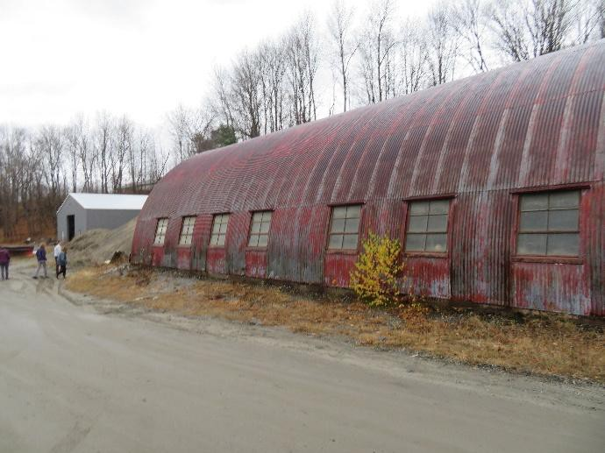
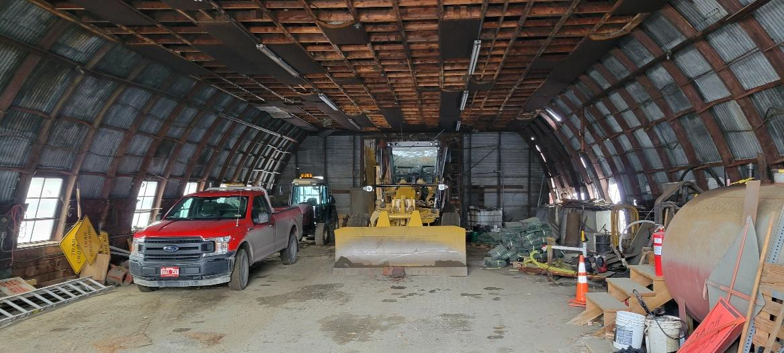
QUONSET HUT
Town of Hardwick – Essential Services
Hardwick, Vermont
January 21, 2026

Slide 10
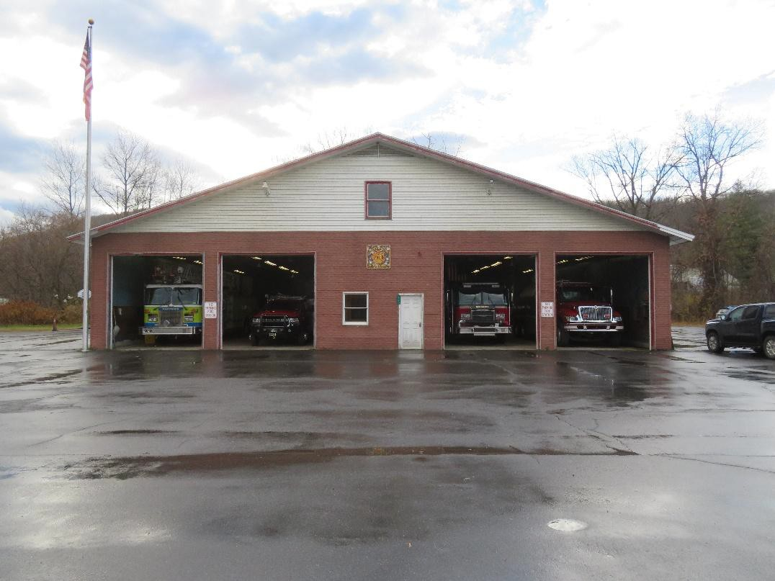
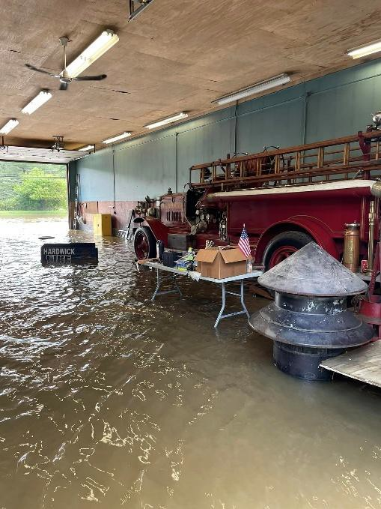
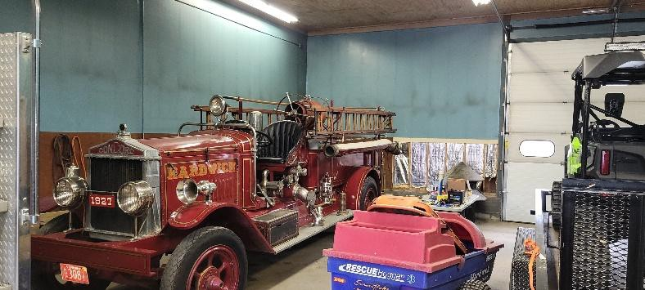
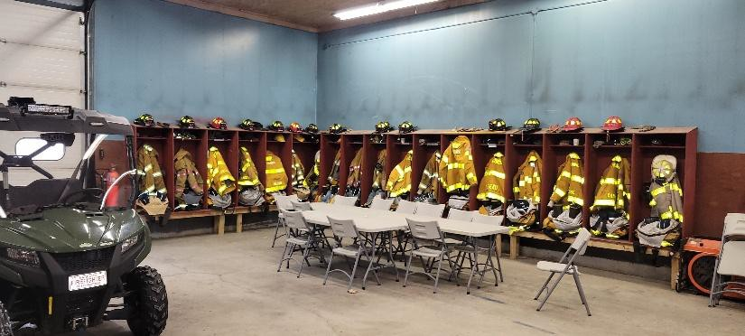
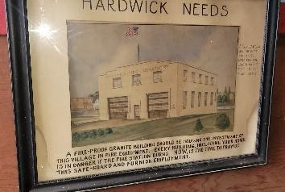
HARDWICK FIRE DEPARTMENT
Town of Hardwick – Essential Services
Hardwick, Vermont
January 21, 2026

Slide 11
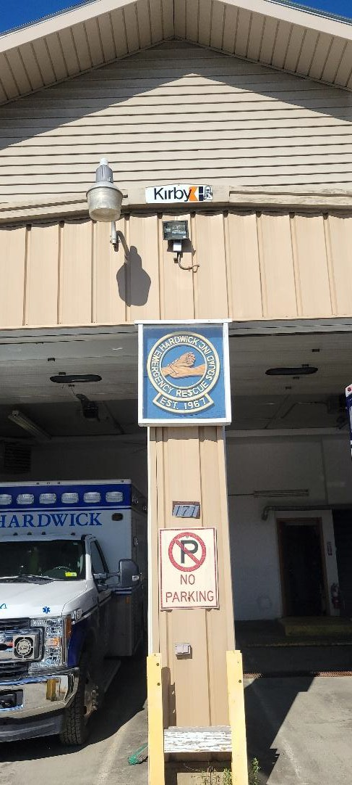
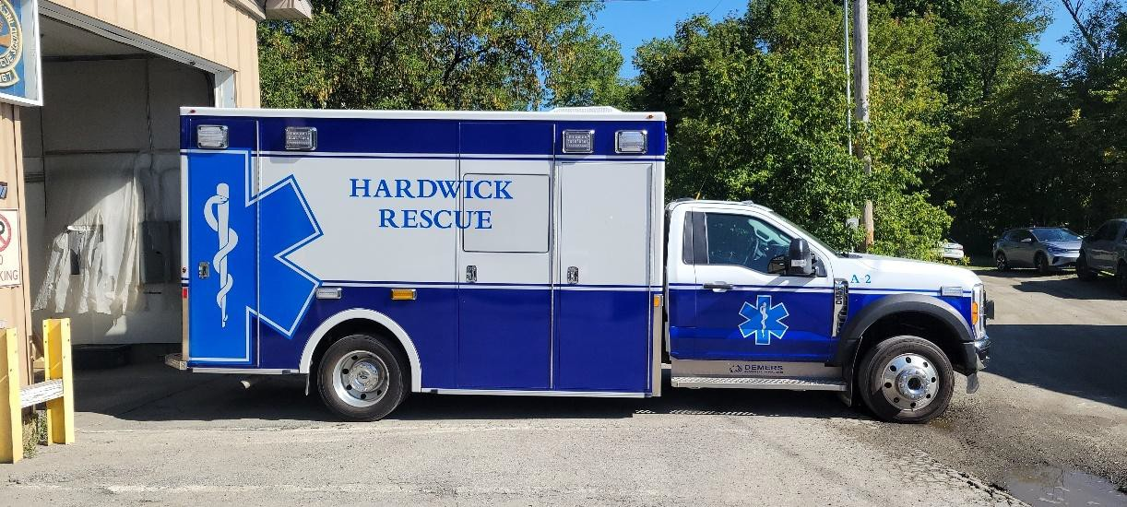
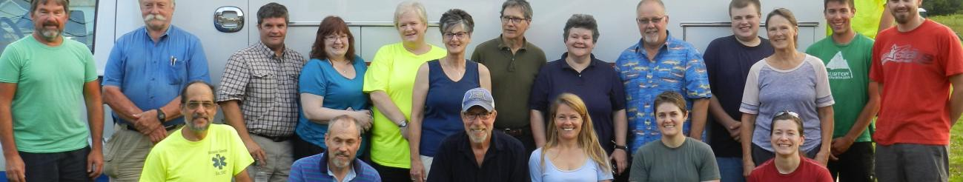
HARDWICK RESCUE
Town of Hardwick – Essential Services
Hardwick, Vermont
January 21, 2026

Slide 12
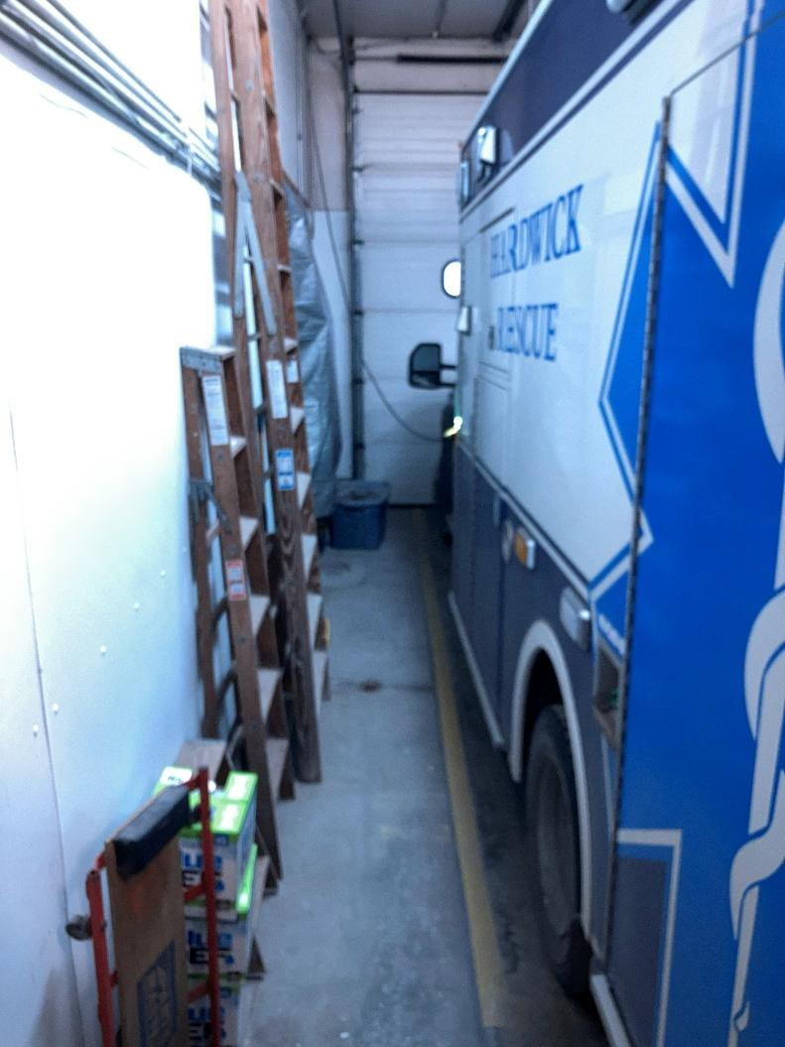
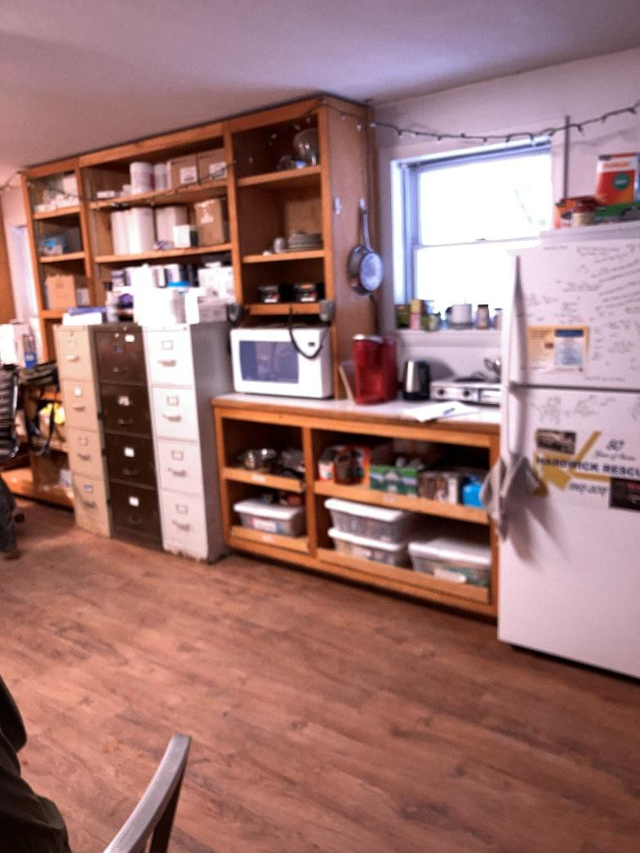
HARDWICK RESCUE
Town of Hardwick – Essential Services
Hardwick, Vermont
January 21, 2026

Slide 13
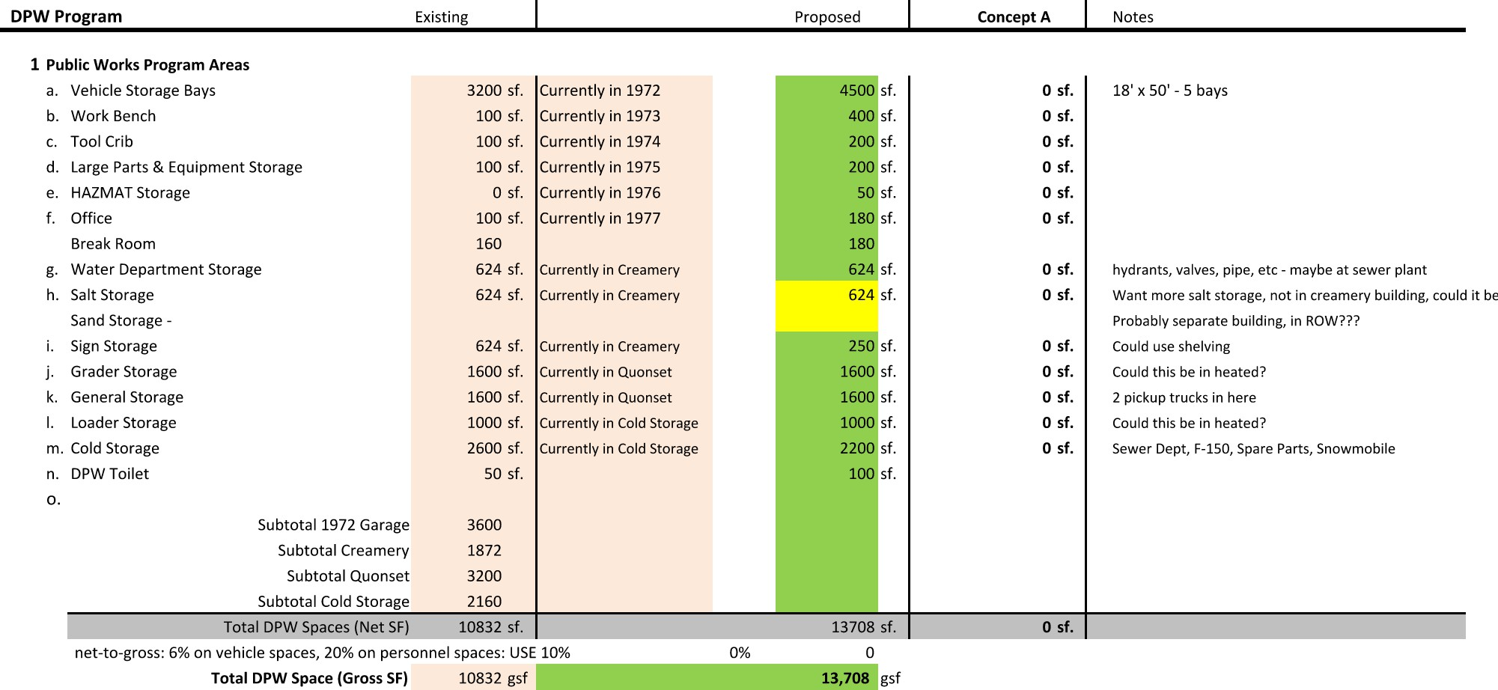
PROGRAM - DPW
SUMMARY:
10,832 SF EXISTING IN MULTIPLE BUILDINGS
13,708 SF PROGRAM (27% Growth)
11,035 NEW SF PROPOSED + 1,872 CREAMERY = 12,907 SF
Town of Hardwick – Essential Services
Hardwick, Vermont
January 21, 2026

Slide 14
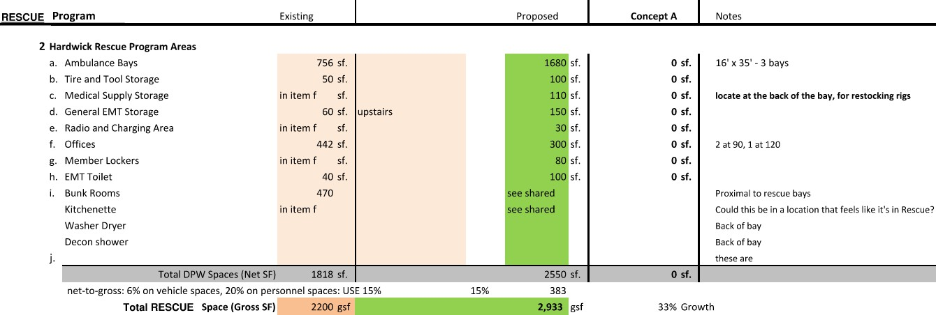
PROGRAM - RESCUE
SUMMARY:
2,200 SF EXISTING
2,933 SF PROGRAM (PLUS SHARED)
6,790 NEW SF PROPOSED (INCL. SHARED)
Town of Hardwick – Essential Services
Hardwick, Vermont
January 21, 2026

Slide 15
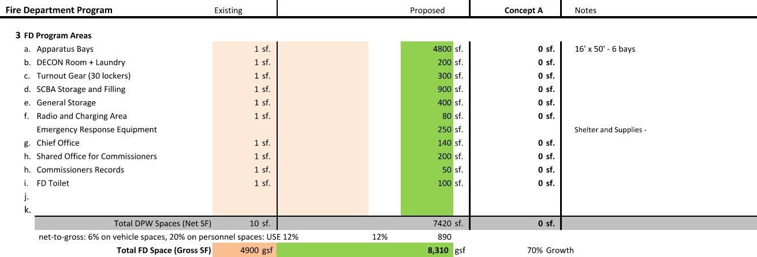
PROGRAM – FIRE DEPT
SUMMARY:
5,880 SF EXISTING
8,310 SF PROGRAM (41% Growth)
7,920 NEW SF PROPOSED
Town of Hardwick – Essential Services
Hardwick, Vermont
January 21, 2026

Slide 16
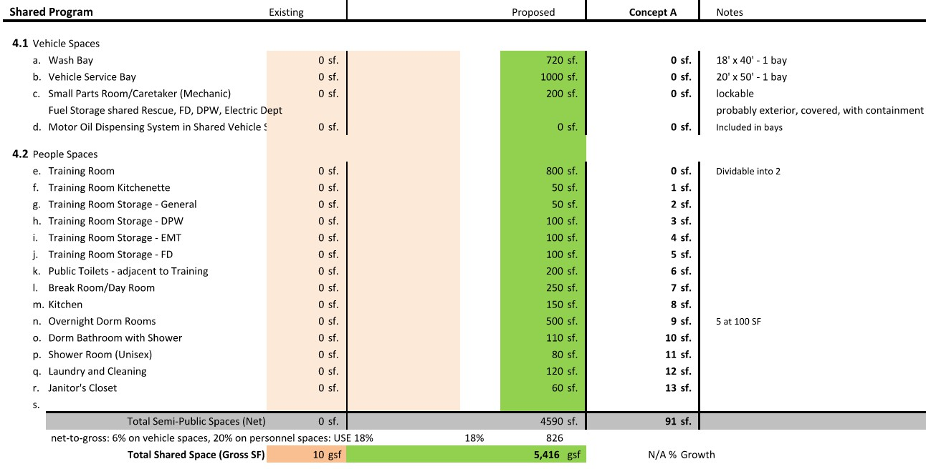
PROGRAM – SHARED
SUMMARY:
0 SF EXISTING
5,416 SF PROGRAM
1,970 NEW SF PROPOSED (See Rescue)
Town of Hardwick – Essential Services
Hardwick, Vermont
January 21, 2026

Slide 17
SITE
Town of Hardwick – Essential Services
Hardwick, Vermont
January 21, 2026

Slide 18
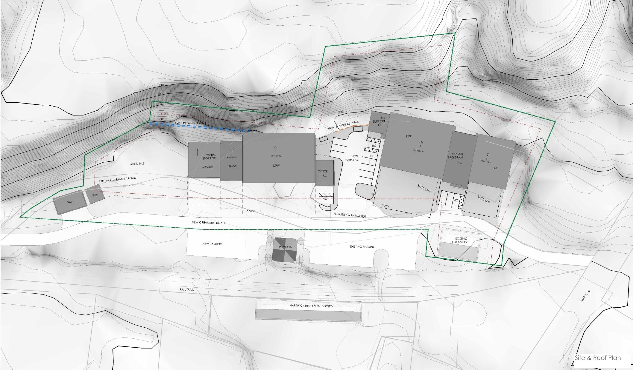
SITE PLAN
Town of Hardwick – Essential Services
Hardwick, Vermont
January 21, 2026

Slide 19
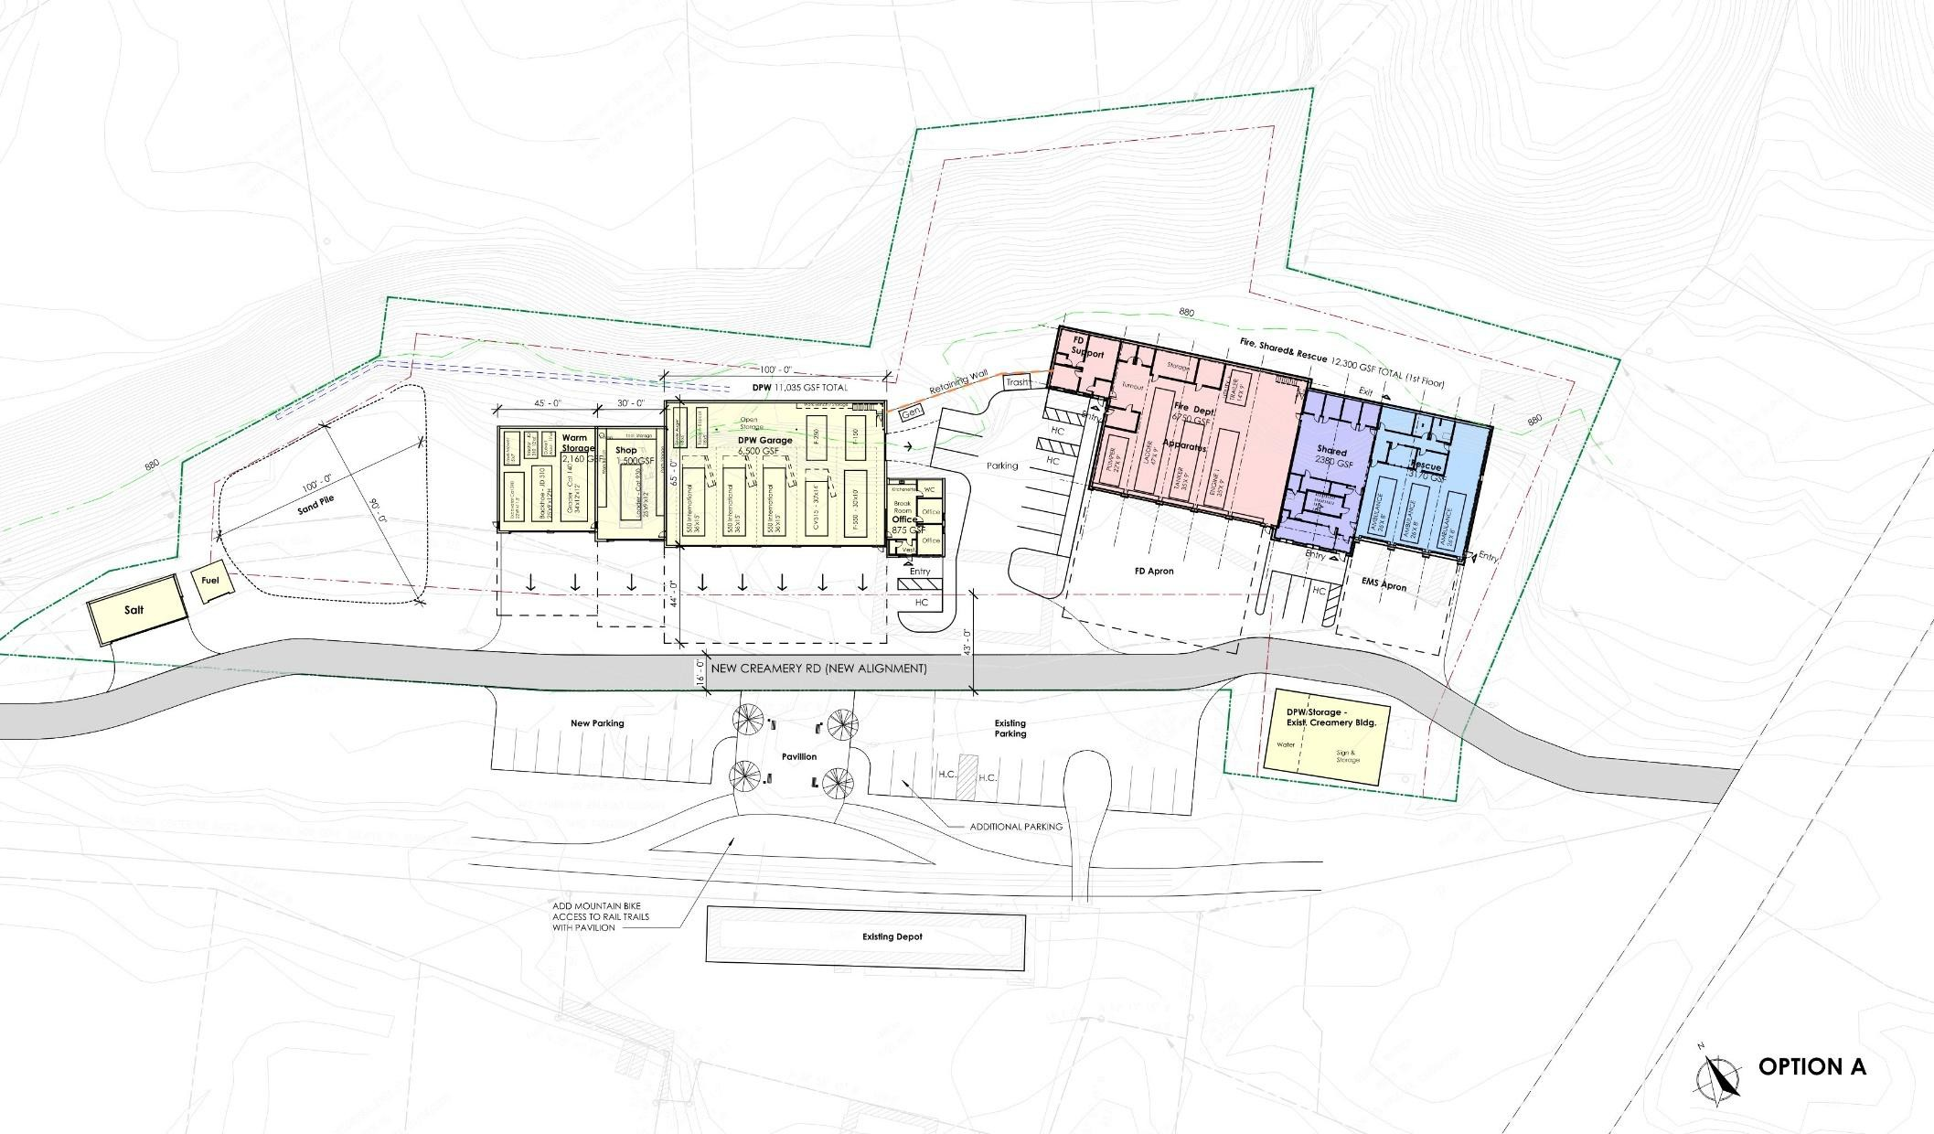
PROGRAM ORGANIZATION
Town of Hardwick – Essential Services
Hardwick, Vermont
January 21, 2026

Slide 20
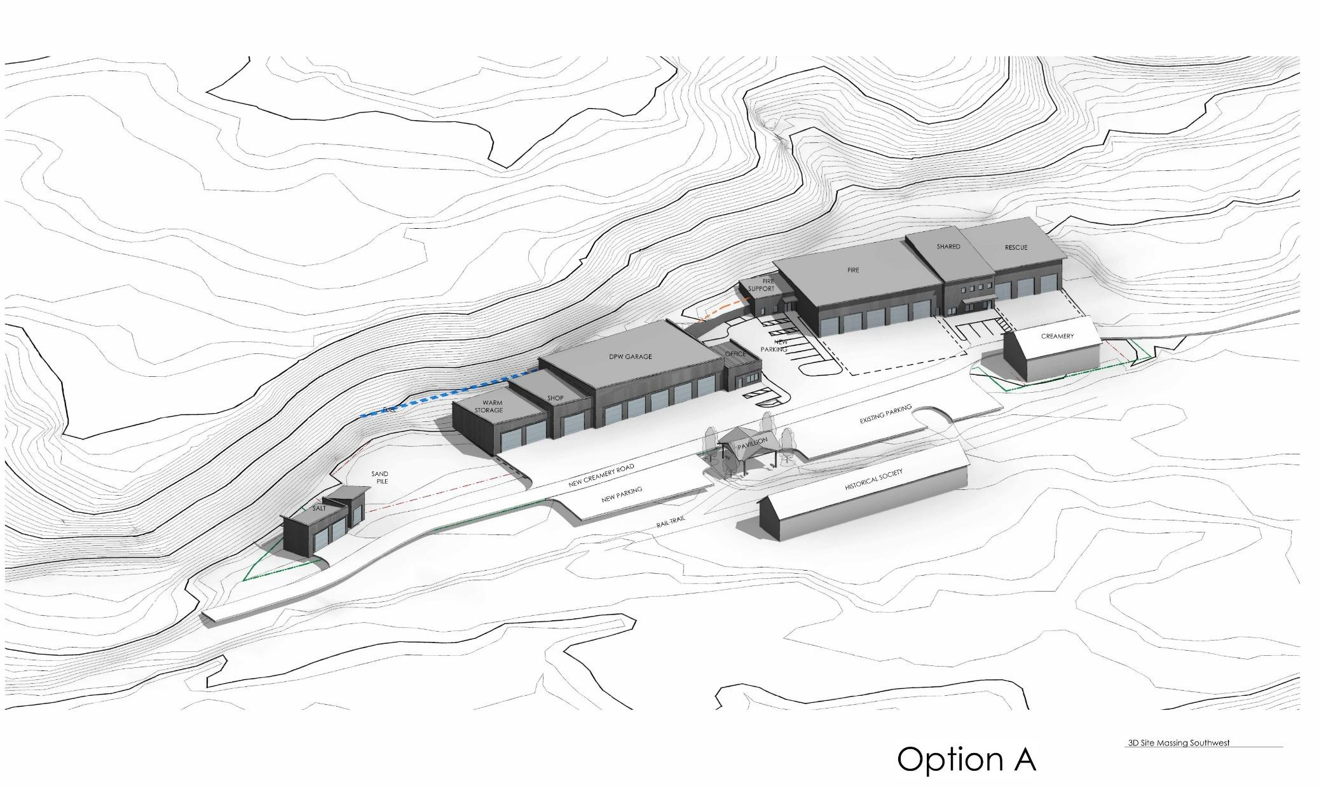
SITE MASSING
Town of Hardwick – Essential Services
Hardwick, Vermont
January 21, 2026

Slide 21
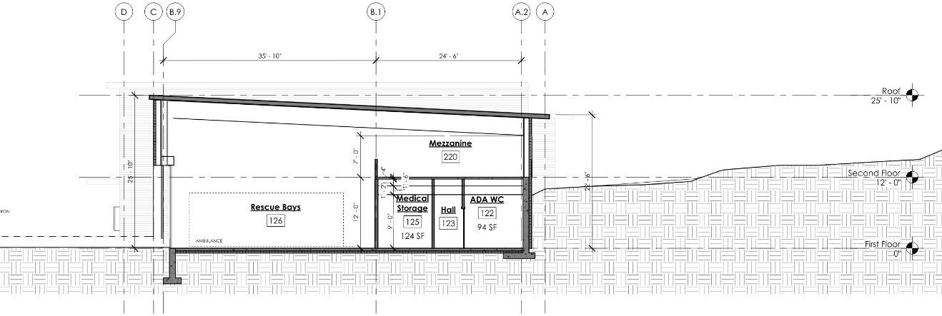
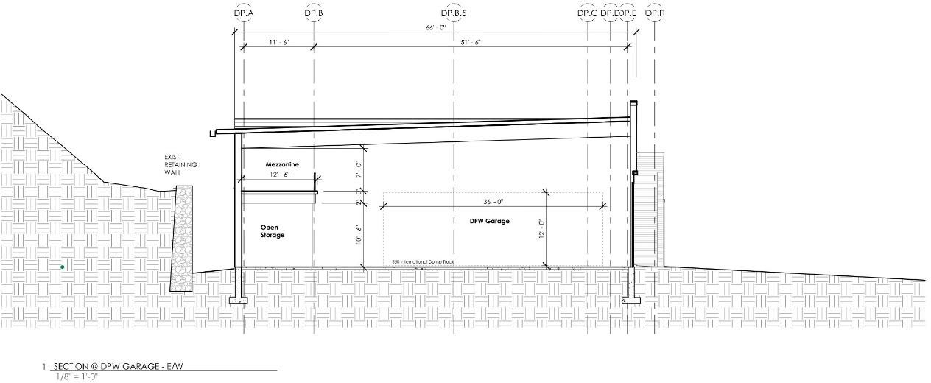
ARCHITECTURAL SECTIONS
Fire & Rescue Section
DPW Section
Town of Hardwick – Essential Services
Hardwick, Vermont
January 21, 2026

Slide 22
FLOOR PLANS
Town of Hardwick – Essential Services
Hardwick, Vermont
January 21, 2026

Slide 23
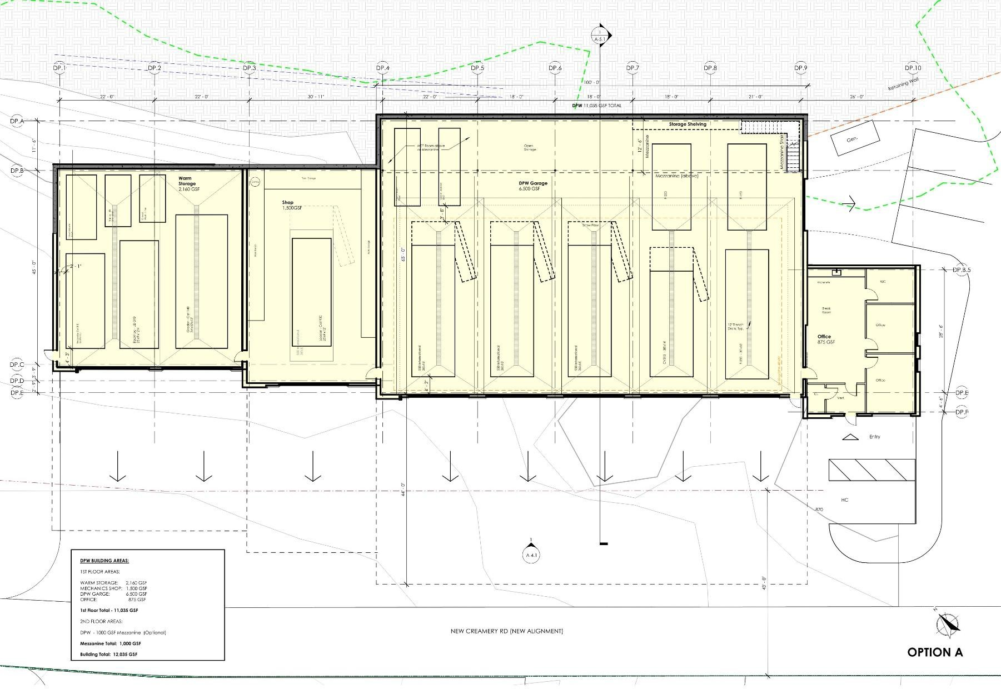
DPW PLAN
Town of Hardwick – Essential Services
Hardwick, Vermont
January 21, 2026

Slide 24
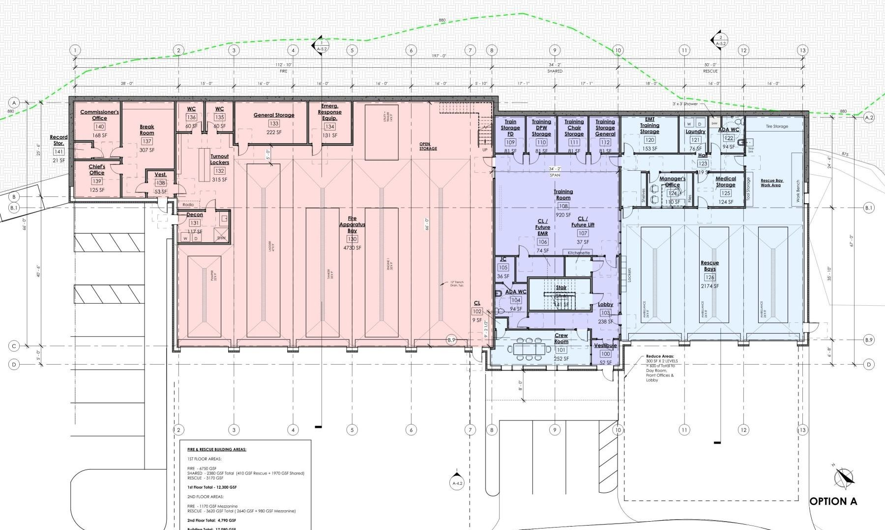
FIRE & RESCUE - FIRST FLOOR
Town of Hardwick – Essential Services
Hardwick, Vermont
January 21, 2026

Slide 25
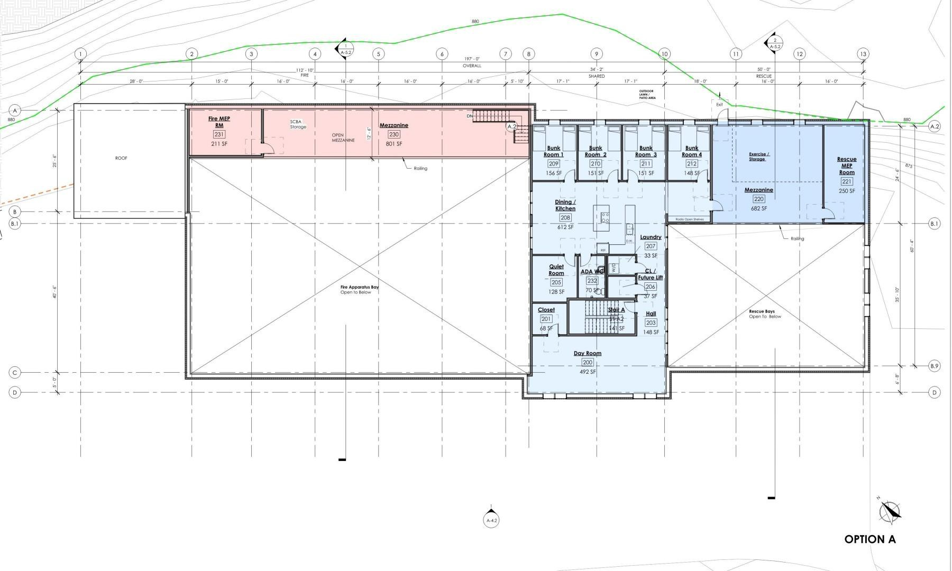
FIRE & RESCUE - SECOND FLOOR
Town of Hardwick – Essential Services
Hardwick, Vermont
January 21, 2026

Slide 26
IMAGES
Town of Hardwick – Essential Services
Hardwick, Vermont
January 21, 2026

Slide 27
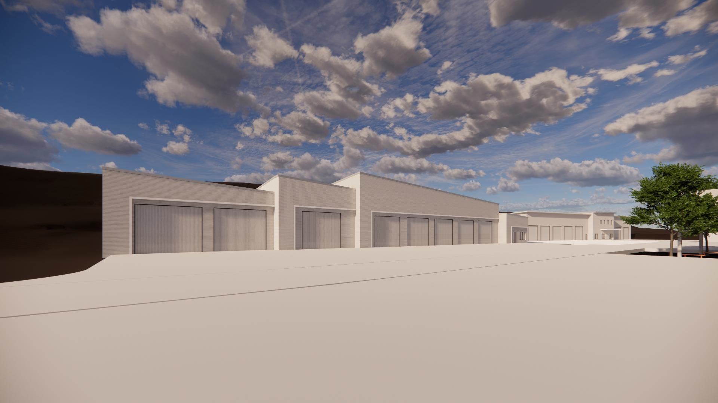
DPW - RENDERING LOOKING EAST
Town of Hardwick – Essential Services
Hardwick, Vermont
January 21, 2026

Slide 28
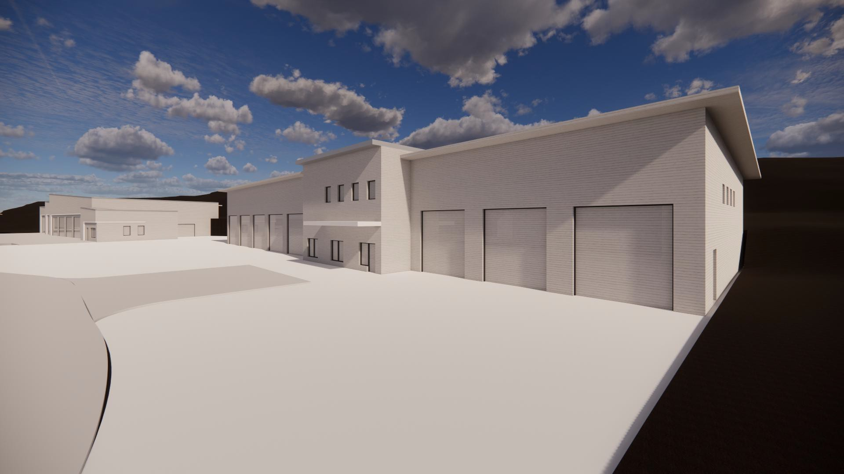
FIRE & RESCUE - RENDERING LOOKING WEST
Town of Hardwick – Essential Services
Hardwick, Vermont
January 21, 2026

Slide 29
BUDGET
Town of Hardwick – Essential Services
Hardwick, Vermont
January 21, 2026

Slide 30
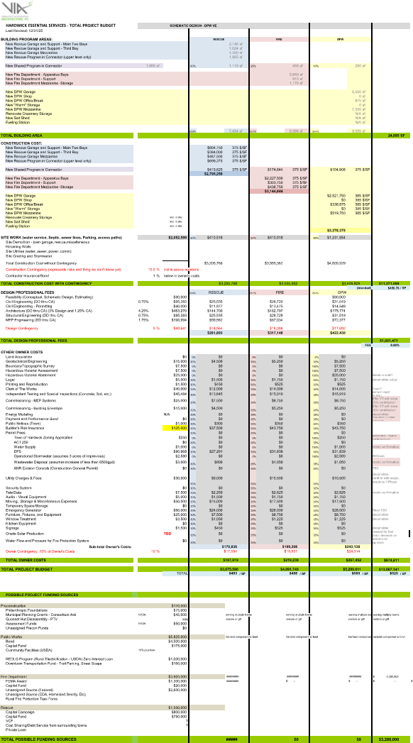
Town of Hardwick – Essential Services
Hardwick, Vermont
January 21, 2026

Slide 31
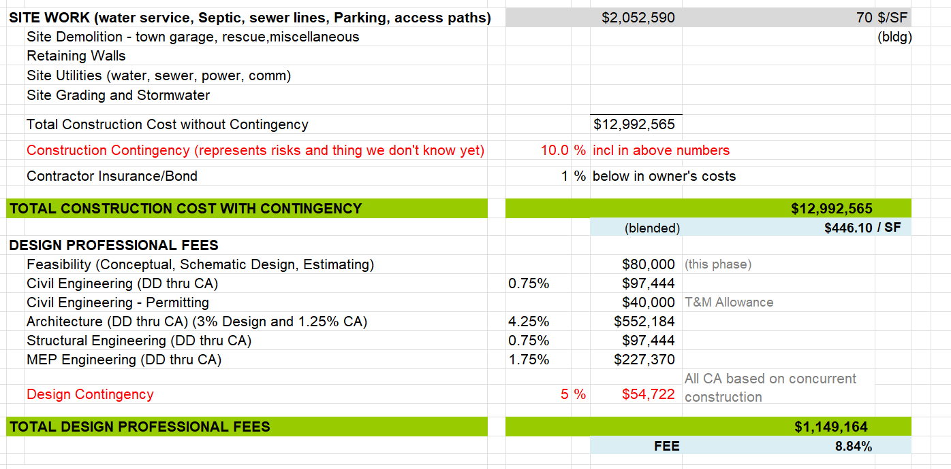
Construction Costs (Hard) = 29,125 GSF Facility , $13 M
Town of Hardwick – Essential Services
Hardwick, Vermont
January 21, 2026

Slide 32
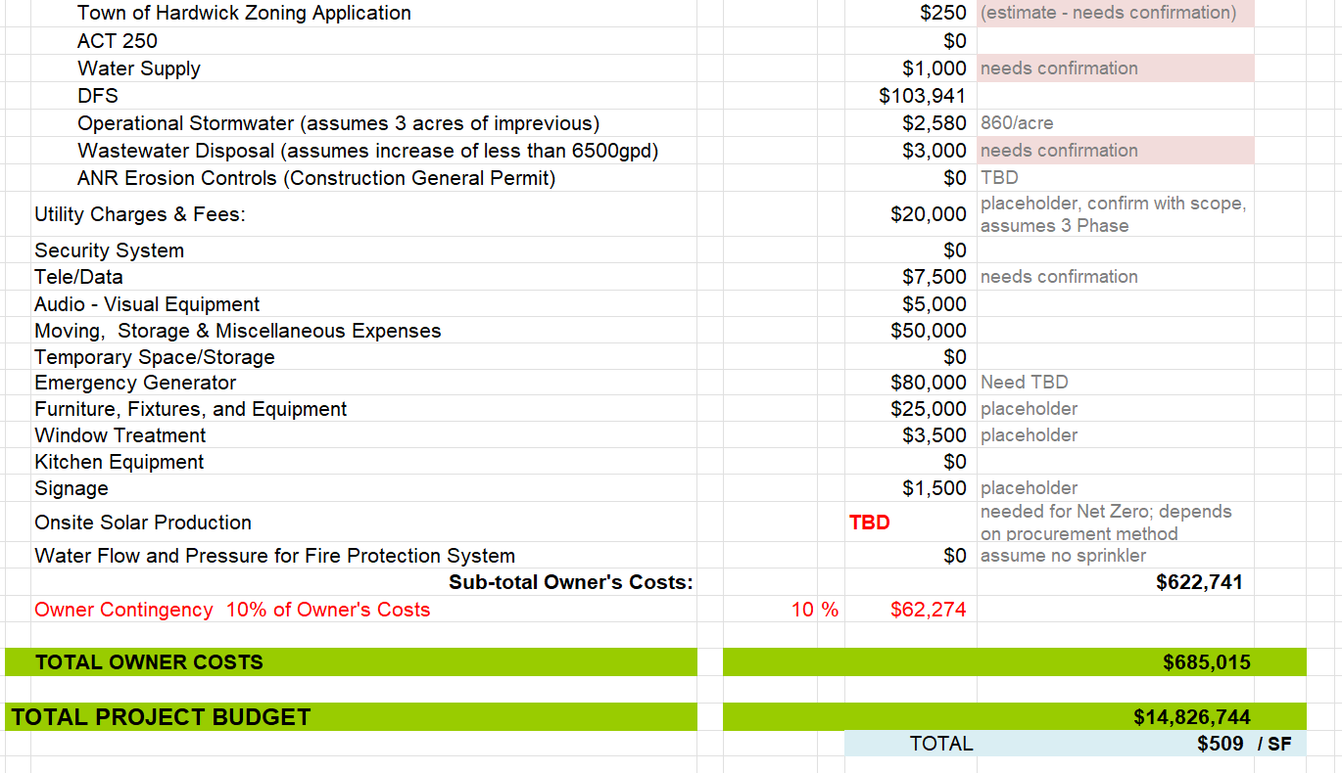
Total Costs (Hard & Soft) = 29,125 GSF Facility , $14.8 M
Town of Hardwick – Essential Services
Hardwick, Vermont
January 21, 2026

Slide 33
BUDGET SUMMARY
ORIGINAL DESIGN | 29,125 SF
Construction Cost | $13.0 Million
Total Project Budget | $14.8 Million
Town of Hardwick – Essential Services
Hardwick, Vermont
January 21, 2026

Slide 34
QUESTIONS/DISCUSSION
Town of Hardwick – Essential Services
Hardwick, Vermont
January 21, 2026

Slide 35
END
Town of Hardwick – Essential Services
Hardwick, Vermont
January 21, 2026

